Slide 1

ICT Fundamentals (ICT 1111)
Introduction, ICT Basics & Parts of Computer System
Prepared By:
Mehedi Hasan Imran
Lecturer, Dept. of Information & Communication Engineering
Bangladesh Army University of Engineering and Technology

Slide 2
Chapter: Concept of ICT

Slide 3
Reference Books for IT Basics
Resources from Internet.
Reference Books for Communication Basics
Introduction to Computer- Peter Norton
Fundamentals of Communication – by M. Shamim Kaiser, Muhammad Arifur Rahman

Slide 4
Reference Books for C language
“Teach yourself C”-by Herbert Schildt.
“Schaum’s outline of programming with C”-by Byron S. Gottfried.

Slide 5
ICT Basics

Slide 6

ICT Basics
ICT stands for Information & Communication Technology.
So, let’s emphasis on these three words to have a brief idea on the subject in which you are going to have your graduation.

Slide 7
Information
Data is processed to produce Information.
Data is the raw fact and information is used to reveal the meaning of data.
Accurate, relevant, timely information is the key to good decision making.
Notes:
Data-Raw Facts, Information- What?, Knowledge-Why?, Wisdom-How?

Slide 8
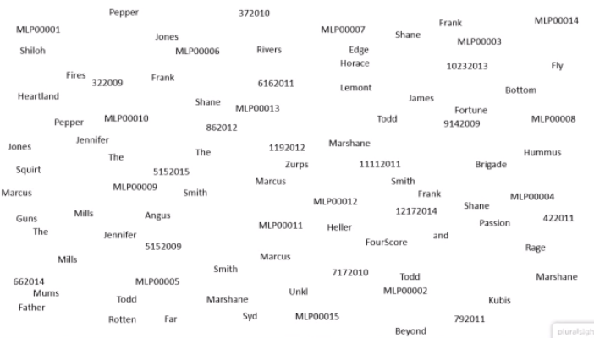
Data

Slide 9
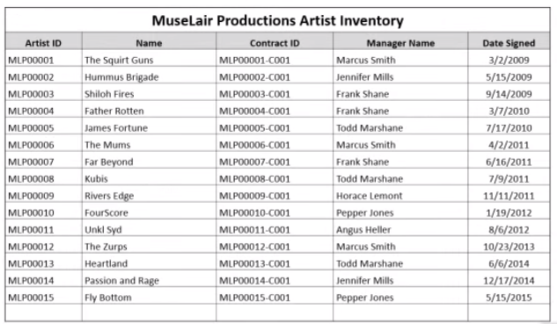
Information

Slide 10
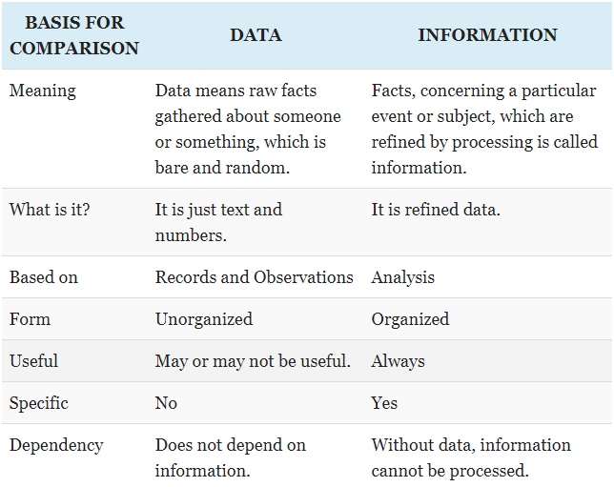

Slide 11
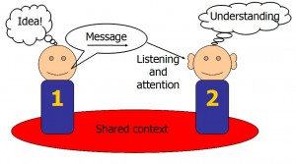
Communication
Communication is essentially about getting a thought from your head into someone else’s head.

Slide 12
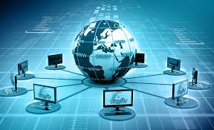
Communication(continued)
In other words, it is to transfer, exchange or share data from one user to other.
It can be wired or wireless.

Slide 13
Technology
The application of scientific knowledge for practical purposes, especially in industry and "advances in computer technology“.
Machinery and equipment developed from the application of scientific knowledge.
The branch of knowledge dealing with engineering or applied sciences.

Slide 14
Brief of ICT
In this era of technological revolution our main concern is to communicate faster with easier means.
We communicate with our desired information.
Technology is the medium of this communication which is in continuous advancement.
Hence, Information Communications Technology (ICT) refers to the study of any technology that uses telecommunication to store, transmit or access digital information. It focuses on the way that modern technology affects our society and how we communicate.

Slide 15
Brief of ICT syllabus
Mainly 4 years syllabus of ICT is a combination of two subjects Information Technology and Communication Engineering.
So, you are going to learn everything related to software development(information system) and communication technologies.
Some subjects of Electrical and Electronics are also covered in the syllabus.
In this course you are going to get some basic ideas about fundamental knowledge related to computer, communication technologies and a programming language named C.

Slide 16
Parts of computer

Slide 17
Computer
An electronic device for storing and processing data, typically in binary form, according to instructions given to it in a variable program.
It comprises mainly of two things:
Hardware
Hardware is any physical component of a computer system that contains a circuit board, ICs, or other electronics. A perfect example of hardware is the screen on which you are viewing this page. Whether it be a computer monitor, tablet or smartphone.
Without any hardware, your computer would not exist, and software could not be used. Ex.: RAM, Hard disk drive, etc.
Software
Software is a general term for the various kinds of programs used to
operate computers and related devices. Ex.: Windows 7, Microsoft Word 2019, etc.

Slide 18
Parts of Computer System
Computer has the following main parts:
Monitor
Central Processing Unit (CPU)
Keyboard
Mouse

Slide 19
Parts of Computer System (continued)
Additional Parts are:
Speakers
Microphone
Printer
Scanner
Battery backup(UPS)
Flash Drive
External Hard drive, etc.
Notes:
UPS: Uninterruptible Power Supply

Slide 20
Input Devices
Keyboard
Mouse
Joy Stick
Light pen
Track Ball
Scanner
Graphic Tablet
Microphone
Magnetic Ink Card Reader(MICR)
Optical Character Reader(OCR)
Bar Code Reader
Optical Mark Reader(OMR)

Slide 21
Output devices
Monitor
Printer
Speaker
Projector
Plotters
Headphones
Visual Display Unit

Slide 22
Peripheral Devices
A computer peripheral is a device that is connected to a computer but is not part of the core computer architecture. The core elements of a computer are the central processing unit, power supply, motherboard and the computer case that contains those three components.
Types of Peripheral Devices
There are many different peripheral devices, but they fall into three general categories:
Input devices, such as a mouse and a keyboard
Output devices, such as a monitor and a printer
Storage devices, such as a hard drive or flash drive

Slide 23
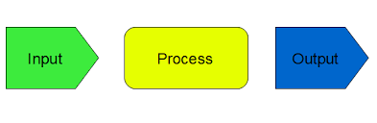
Data Processing Cycle
Data processing cycle as the term suggests a sequence of steps or operations for processing data
Stages of data processing:
Input – The raw data after collection needs to be fed in the cycle for processing. This is considered the first step and called input.
Processing – Once the input is provided the raw data is processed by a suitable or selected processing method. This is the most important step as it provides the processed data in the form of output which will be used further.
Output – This is the outcome and the raw data provided in the first stage is now “processed” and the data is useful and provides information and no longer called data.

Slide 24
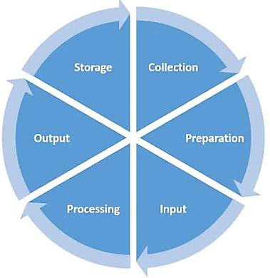
Stages of the Data Processing life Cycle
data processing have three broad stages which have sub stages or steps involved. These are the steps/ process required in between these three broad stages. These deal with the collection of data, choosing the processing methods, practicing data management best practices, information processing cycle, making use of processed data for the desired purpose.

Slide 25
Data Collection: This is the first step which will provide the data for the input. Collecting data is a hard work in its own but is most essential on which the results depend. The quality of input will determine the quality of output. This data collection can be done in various ways by primary or secondary sources.
Preparation: Preparation includes sorting and filtering of data which will finally be used as input. This stage required you to remove the extra or unusable data to make processing faster and better.
Input: This is the feeding of raw and sieved data for processing. If the input is not done properly or done wrong, then the result will be adversely affected.
Processing: This is the step where data is processed by electronic data processing, mechanical processing or automated means. The processed data is one who gives information to the user and can be put to use.

Slide 26
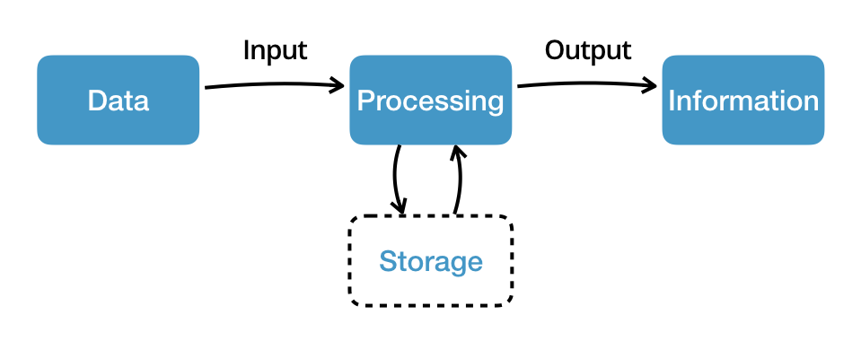
Output/ Result : This is the last step of the data processing cycle as the processed data is delivered in the form of information/results in this step. Once the result or output is received, it may further be processed or interpreted. This is done by the user or software for further value addition. This output can also be used directly in presentations or the records. This output may even be saved as to be used as an input for further data processing which then becomes a part of a cycle which is being discussed. If this data is not used as input, then this complete process cannot be considered as cycle and will remain to be a one-time activity of data processing. For using this data as input, it must be stored or simultaneously be available for further processing.

Slide 27
What is information technology?
Information technology (IT) is the use of any computers, storage, networking and other physical devices, infrastructure and processes to create, process, store, secure and exchange all forms of electronic data
What does information technology encompass?
The IT department ensures that the organization's systems, networks, data and applications all connect and function properly. The IT team handles three major areas:
1.deploys and maintains business applications, services and infrastructure (servers, networks, storage);
2.monitors, optimizes and troubleshoots the performance of applications, services and infrastructure; and
3.oversees the security and governance of applications, services and infrastructure.

Slide 28
Communication Technology
Communication is the exchange of information through different mediums.
There are four main types of communication technology that have contributed to the ease of sending messages: telephone, radio, television, and internet.

Slide 29
Probable Questions
Define Information, Data.
What do you think about Communication?
Explain communication with suitable figure.
Define hardware, software.
List main parts of computer.
List five input, output devices.
Illustrate data processing cycle with proper diagram.
Describe stages of the data processing cycle.
What is information technology?
What does information technology encompass?

Slide 30
Thank you

